Slide 1
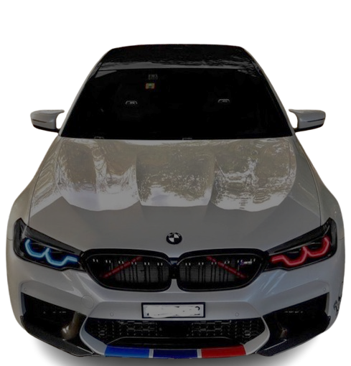


BMV
PRESENTATION

Slide 2

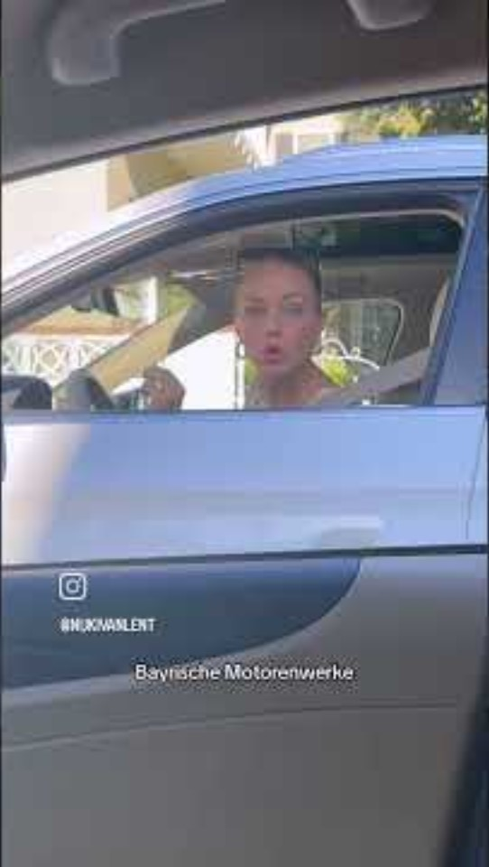
Notes:
youtube.com/shorts/gL3TJTtQWSc?embeds_referring_euri=https%3A%2F%2Fhubblecontent.osi.office.net%2F&source_ve_path=Mjg2NjY

Slide 3
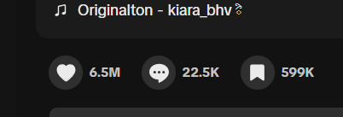

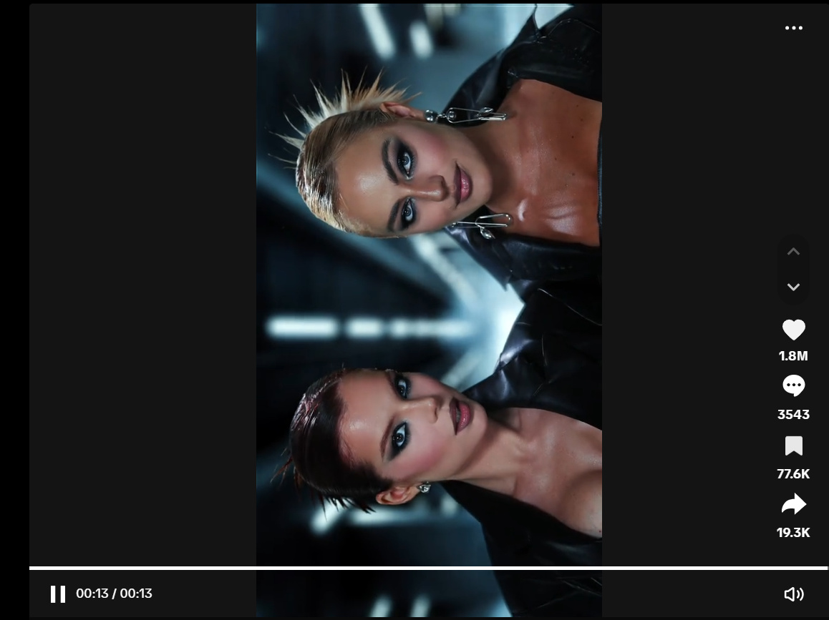
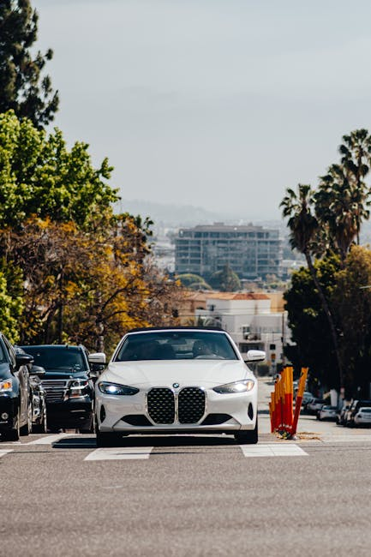
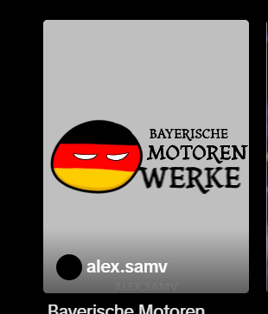

Slide 4
Outlines
What Does BMW Stand For?
Where was the logo got inspired from ?
Historical View
BMW Community
Sales Success & Global Ranking
Closing Video

Slide 5
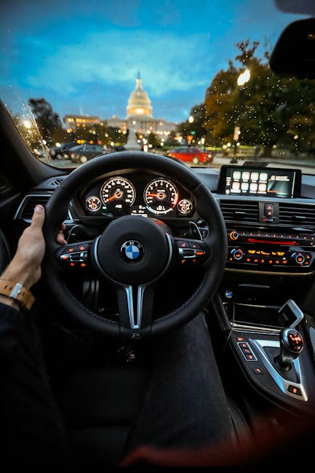
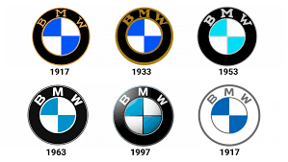

What Does BMW Stand For?
Bayerische Motoren Werke
BMW stands for Bayerische Motoren Werke, or Bavarian Motor Works in English. The name reflects its roots in Bavaria, Germany. While many think the logo is based on a spinning wheel, it actually represents the blue and white colors of the Bavarian flag.
Bavarian flag

Slide 6
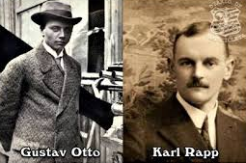
BMW was founded in 1916 in Munich, Germany. The founders were Karl Rapp (Rapp Motorenwerke) and Gustav Otto (Otto Flugmaschinenfabrik), whose companies merged and evolved into Bayerische Motoren Werke AG—better known as BMW.
At first, BMW made aircraft engines during World War I, then moved into motorcycles in 1923, and finally cars in 1928.

Slide 7
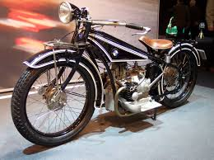
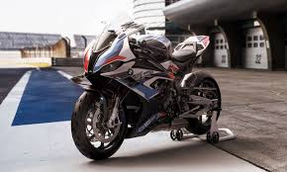
Shift to Motorcycles
First Motorcycle: R32
In 1923, BMW launched the R32, its first motorcycle.
Legacy Continues
BMW motorcycles remain a core part of the brand’s portfolio, with modern models blending heritage and cutting-edge tech.
BMW M 1000 RR

Slide 8
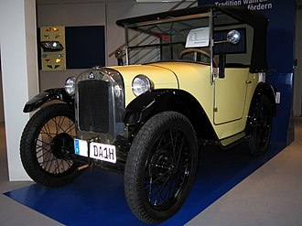
First Cars
Dixi Acquisition
In 1928, BMW acquired Fahrzeugfabrik Eisenach, makers of the Dixi, marking its entry into automobile production.
Automotive Beginnings
This move set BMW on the path to becoming one of the world’s most renowned car manufacturers.
BMW Dixi

Slide 9
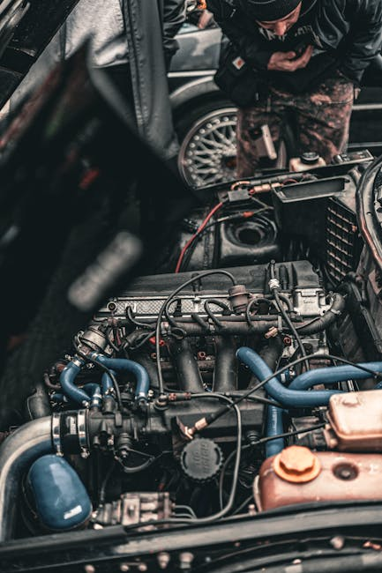
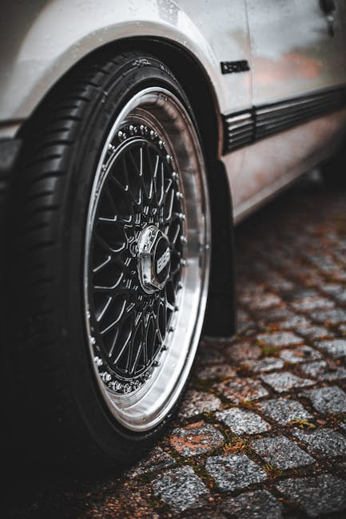
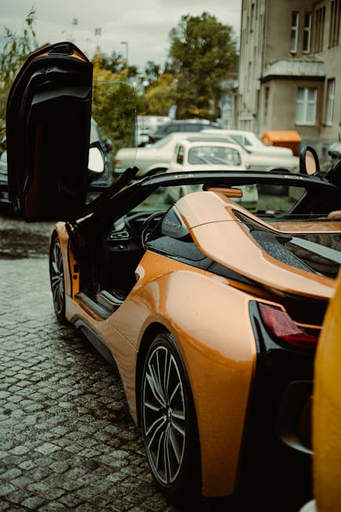
Racing Legacy
From touring cars to Le Mans and Formula 1, BMW has a rich motorsport history that showcases its engineering and performance credentials.

Slide 10
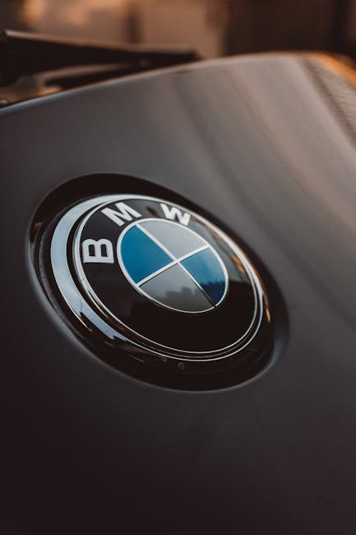
Engineering Innovations
50/50 weight distribution
Rear-wheel drive dynamics
iDrive infotainment system
Carbon fiber chassis advancements

Slide 11

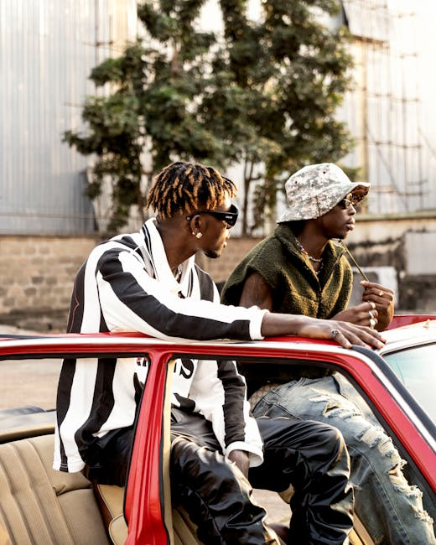
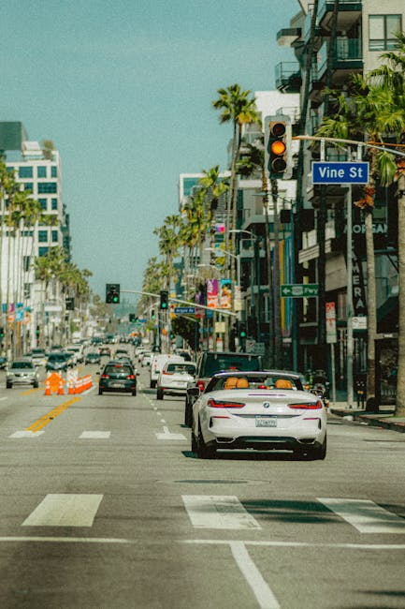
BMW in Pop Culture
From James Bond films to chart-topping music videos, BMW has become a symbol of style, performance, and aspiration across entertainment media.

Slide 12
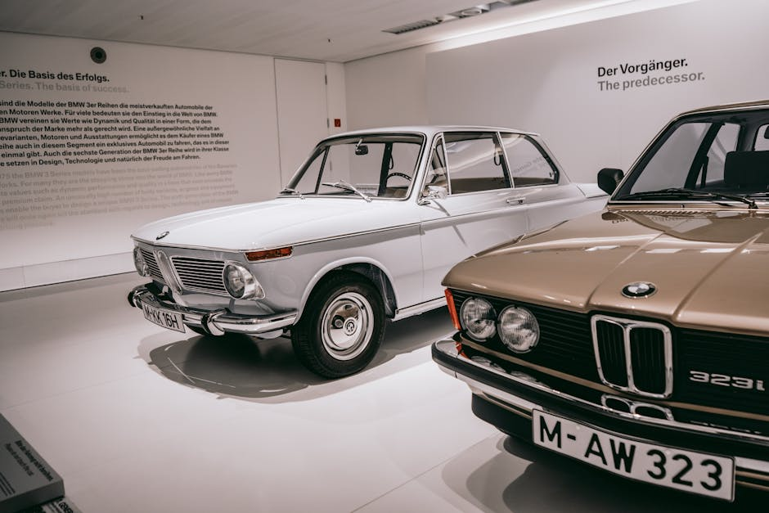
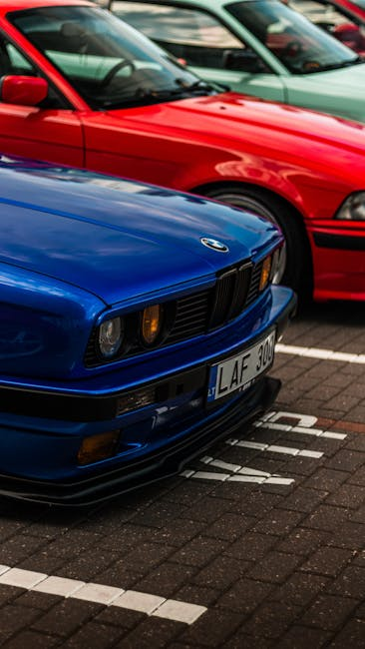
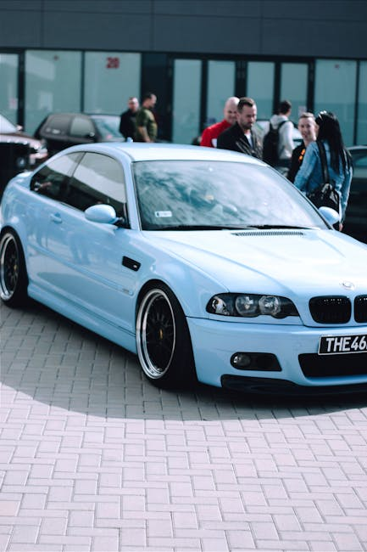
BMW Community
BMW owners and fans gather across the globe for car meets, rallies, and enthusiast events, fostering a vibrant culture of shared passion.

Slide 13
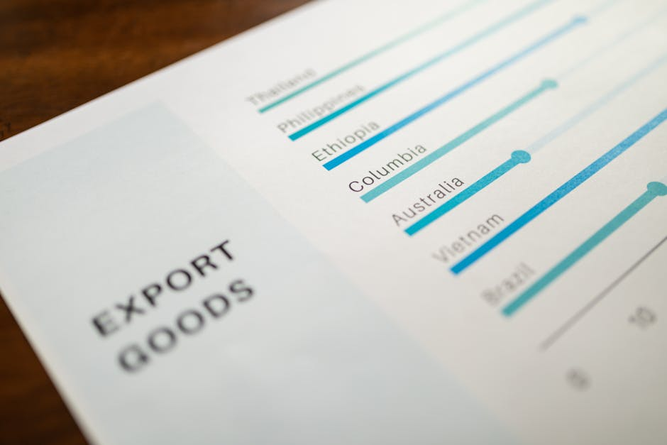
Sales Success & Global Ranking
2024 sales: ~2.55 million vehicles worldwide
Top 3 premium automaker globally (with Mercedes & Audi)
Luxury EV sales leading segment with i4 and iX
Strong growth in China, Europe, and North America
Consistent double-digit EV growth year-over-year

Slide 14
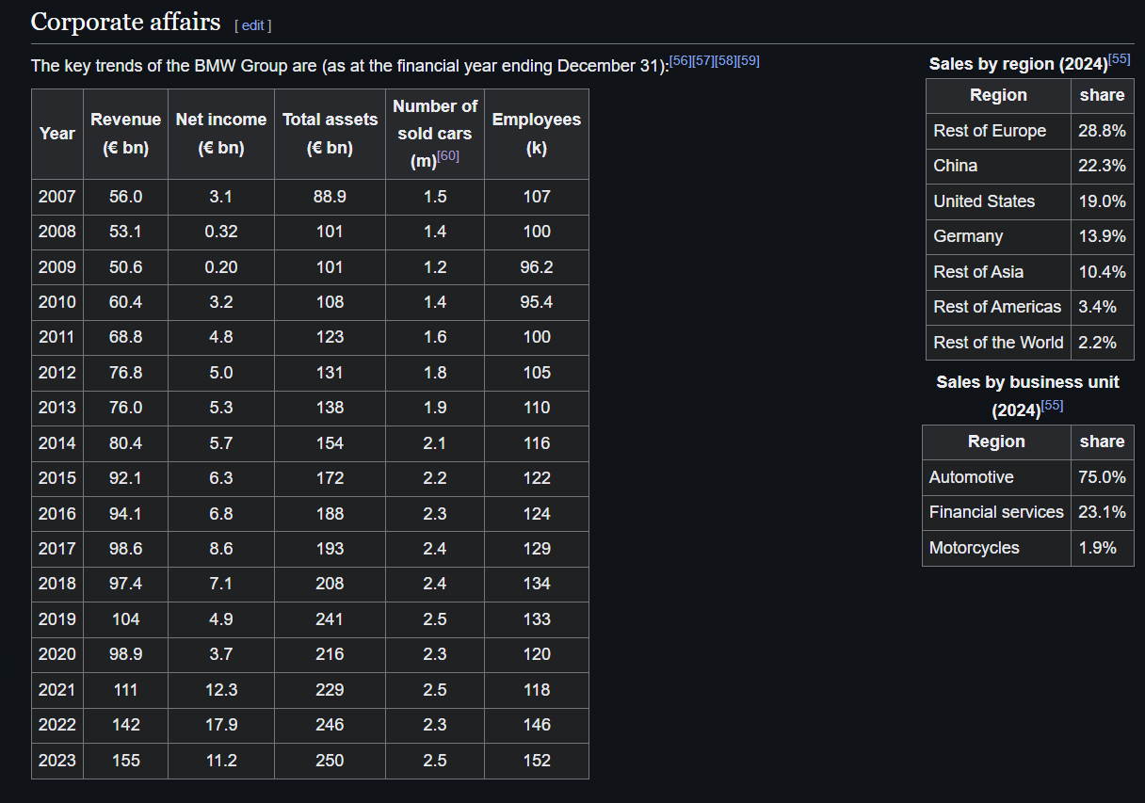
Sales Success

Slide 15

Sustainability & Innovation
Carbon neutrality by 2050
Circular production model
Use of eco-friendly materials
Investment in renewable energy
Innovative recycling processes

Slide 16
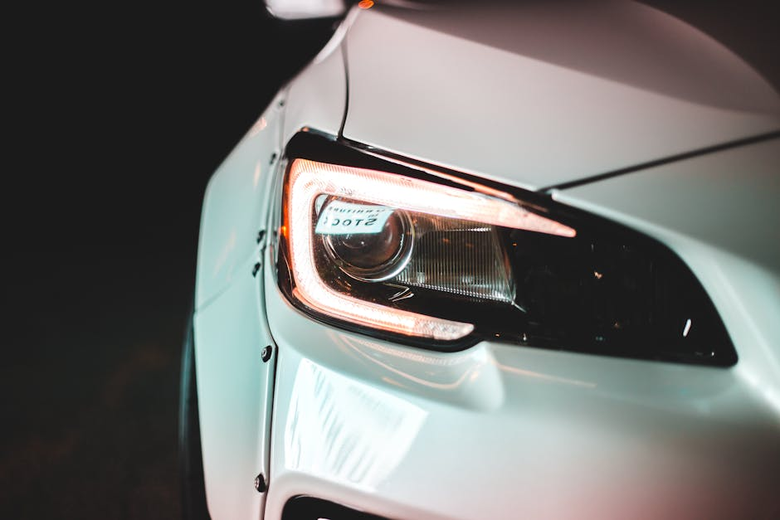
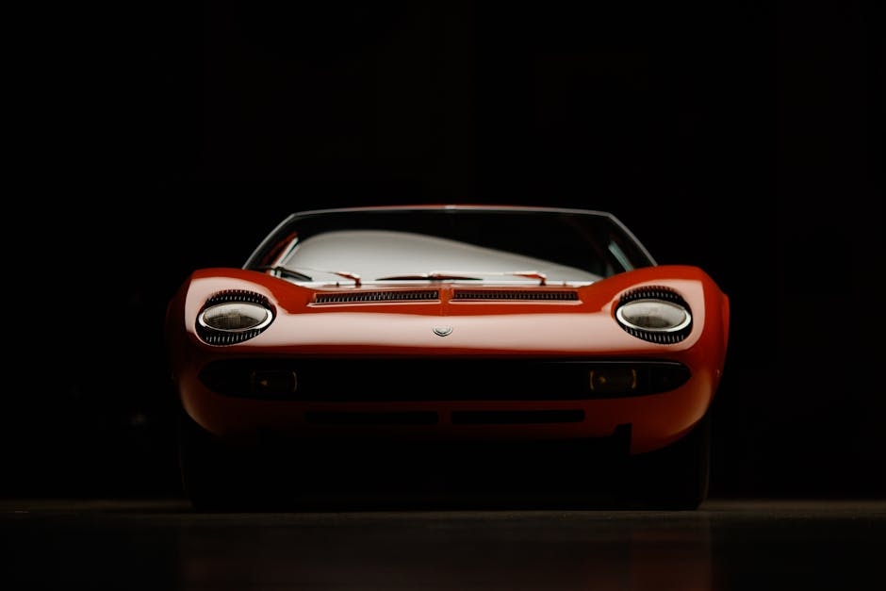
Why BMW is Iconic
A perfect blend of performance, heritage, culture, and modern market success keeps BMW at the top of automotive prestige.

Slide 17
Closing Video

Slide 18

SHE ENDED UP IN TO AUDIES NOT BMWS

Slide 19
Q&A

